Slide 1
CLTV Predictive Segmentation for personalized insurance policies
Course ID: CSE 572
Group: 21
Members:
Shreyas Hingmire
Nayan Bhiwapurkar
Sudeeksha Vandrangi
Vaishnavi Chunchu
Toshal Warke
Notes:
Hi everyone,
It gives us great pleasure to welcome you to our project presentation for the CSE 572 course. We chose to explore a dataset that holds the intricate details of customer interactions and policy dynamics and forecast the Customer Lifetime Value (CLTV) and engage in predictive segmentation to tailore personalized insurance policies.

Slide 2
Outline:
Introduction
Background, what, why, intro to dataset
05
Future Work
.
01
04
Implementing ML Models
EDA
02
03
Data Pre-Processing
Notes:
Moving forward, this is the outline of our presentation.

Slide 3
Introduction:
Background: Vahan Bima, a leading Indian motor vehicle insurance company, seeks to enhance customer experience through personalized programs.
What: The project involves building a machine learning model to predict Customer Lifetime Value (CLTV) based on user and policy data, and segment customers into different segments
Why it matters: By using CLTV and segmenting customers, the company aims to strategically personalize services, improving customer satisfaction and loyalty.
Notes:
A little background regarding the project. Vahan Bima is a prominent motor vehicle insurance company and they wish to forecast the CLTV based on the user and policy data. They further seek to segment the customers based on the data to improve their satisfaction and loyalty through personalized programs.

Slide 4
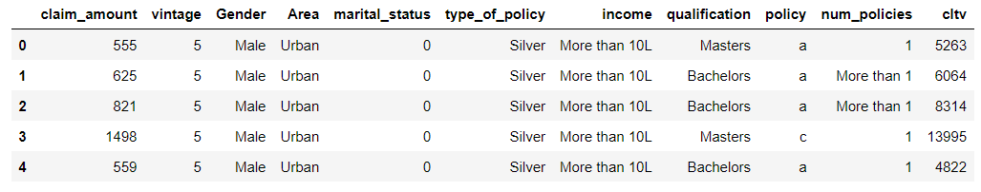
Problem Formulation
Dataset Overview: The dataset consists of detailed information about customers and their engagement with different customer policies.
Goal: To predict the CLTV metric, based on customer and policy features; Regression task
Segment the customers for enhanced personalized policies; Clustering task
Notes:
Moving forward, let's now take a look at the dataset:
The VahanBima dataset provides a comprehensive snapshot of customer and policy information, serving as a valuable resource for predictive modeling. Key features include unique customer identifiers (id), gender, area, highest qualification, annual income, marital status, vintage (years since the first policy), total claimed amount (claim_amount), the number of policies issued (num_policies), details of the active policy, type of policy, and the target variable - Customer Lifetime Value (CLTV).
This dataset is particularly well-suited for regression tasks aiming to predict CLTV, allowing the development of models that can forecast the long-term value of customers. The diverse set of features, ranging from demographic information to policy details, offers the potential to uncover complex relationships and patterns that influence customer lifetime value.
Additionally, the dataset could be used for clustering tasks to segment customers based on shared characteristics, aiding VahanBima in tailoring personalized experiences and optimizing customer engagement strategies.
However, potential challenges include handling outliers, addressing multicollinearity, and ensuring appropriate preprocessing for effective model development. Overall, the VahanBima dataset provides a rich foundation for data mining tasks aimed at enhancing customer experience and strategic decision-making within the insurance company.

Slide 5
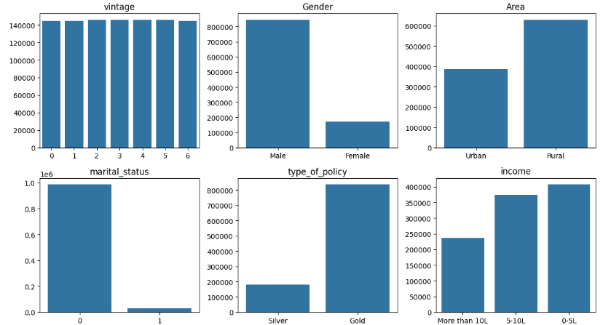
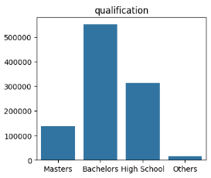
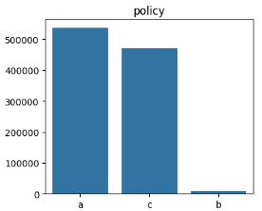
Exploratory data analysis (EDA)

Slide 6
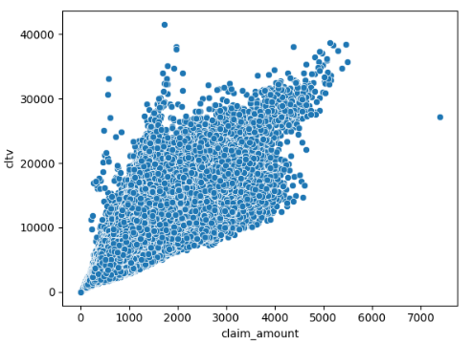
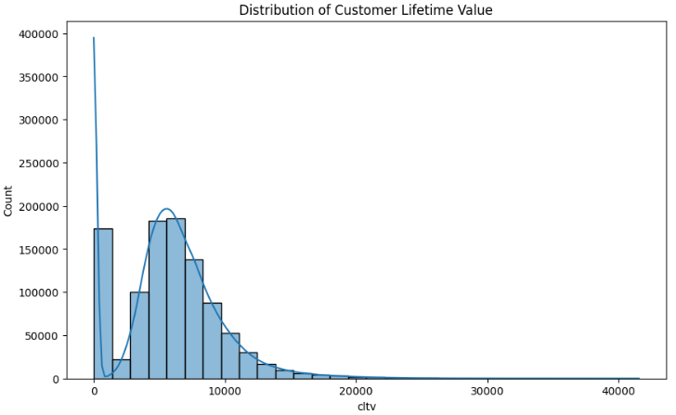
Exploratory data analysis (EDA)

Slide 7
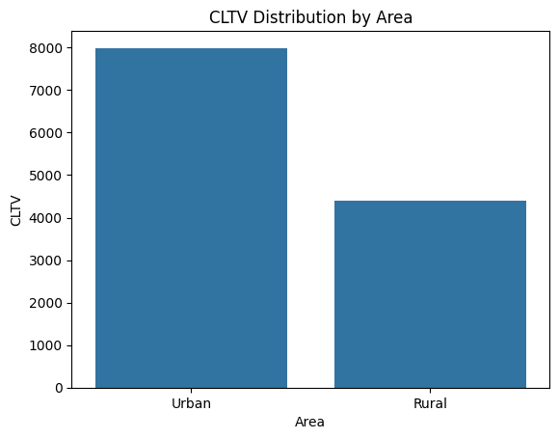
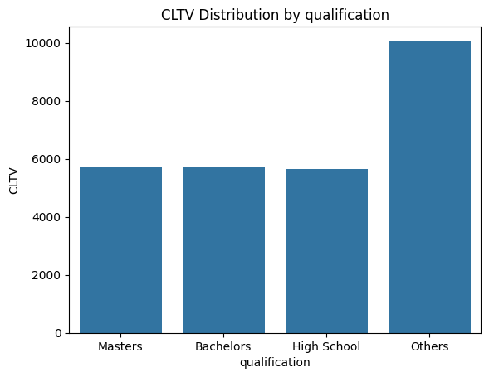
Exploratory data analysis (EDA)

Slide 8
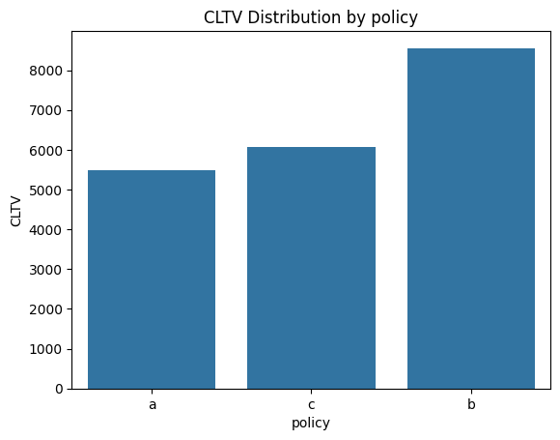
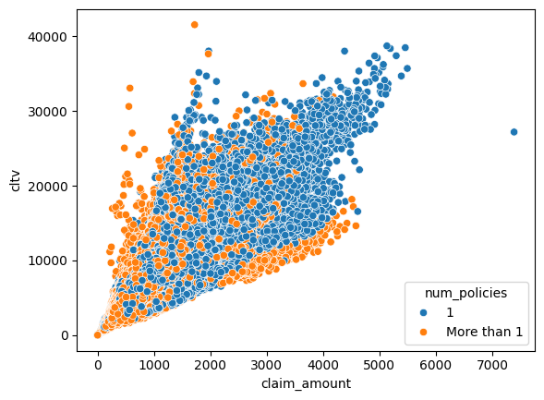
Exploratory data analysis (EDA)

Slide 9
Data Preprocessing
Handling Categorical Columns
One Hot Encoding
Handling Ordinal Columns
Label Encoding
Normalization

Slide 10
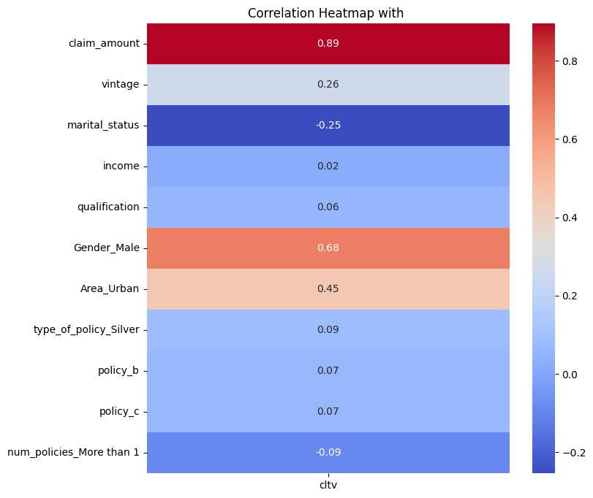
Feature Engineering - Removed Income Column

Slide 11
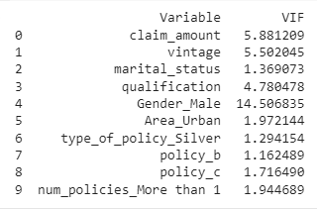
Variance Inflation Factor (VIF)
Removed Gender_Male Column

Slide 12
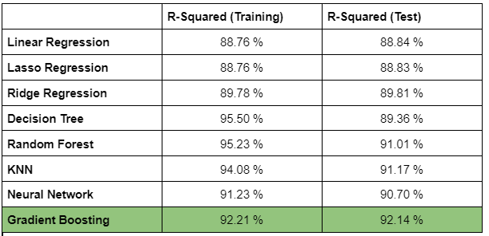
Implementing ML Models

Slide 13
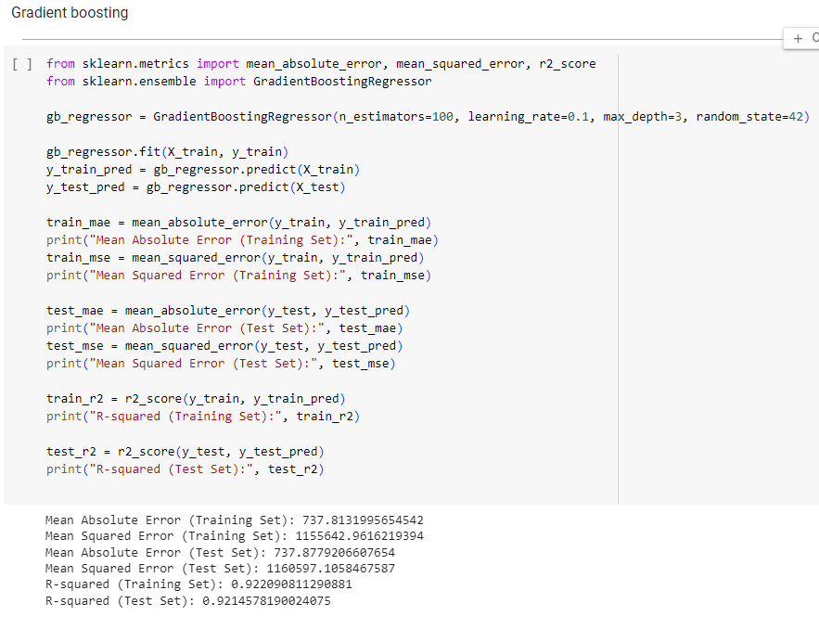

Slide 14
Challenges
Past Challenges
Running Time
Model Selection
Potential Future Challenges
Overfitting
Finding Optimal Number Of Clusters

Slide 15
Data Mining System Pipeline
Data Collection
Data Pre-Processing
Encoding, Normalization
, Feature Engineering
EDA
Exploratory Data Analysis
Model Selection
Selecting ML model based on validation dataset accuracies
Train
different
ML models
on Training Dataset
Data Splitting
(Train, Test, Validation)
Calculate Accuracy
of Model
on Test Dataset
Improve Accuracy
(Hyper-parameters, K-Fold)
Clustering Customers

Slide 16
Future Work
Outlier Management
Removing/Handling Outliers
Model Tuning
Hyperparameter Tuning
Model Validation
K-fold Cross Validation
Dimensionality Reduction
PCA (Principal Component Analysis)
Clustering

Slide 17
THANK YOU

